Slide 1
High-performance computing for scientific and applied problems
Project participants
Vavroch Ondrej (University of West Bohemia)
Rahimzade Sara (Baku State University)
Project supervisors
D.V. Podgainy
O.I. Streltsova
A.Nechaevskiy
JINR-LIT

Slide 2
AIM OF THE PROJECT
Learning parallel programming technologies for carrying out computations on hybrid platforms: MPI, OpenMP, CUDA, and hybrid technologies
Framework for speed comparison

Slide 3
PARALLEL COMPUTING
Parallel computing is a type of computation in which many calculations or the execution of processes are carried out simultaneously.
The main aims of the parallel programming:
Attempt to divide a single problem into multiple parts
Distribute the segments of problem amongst various processes
Provide a platform layer to manage data exchange between multiple processes that exchange solve a common problem simultaneously
Parallel programming (computations) can be realized on:
Multi-core processors
Clusters
Networks

Slide 4
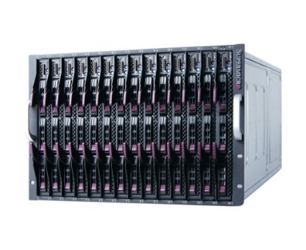
HybriLIT
The cluster contains 10 computational nodes with graphical accelerators NVIDIA Tesla K20X, K40, K80, Intel Xeon Phi 7120P, 5110 coprocessors. All computational nodes include two Intel Xeon E5-2695v2 and V3 processors each.
Computation component HybriLIT
7 blades include specific GPU accelerator sets. Driven by NVIDIA CUDA software.
1 blade includes 2 PHI accelerators. Driven by Intel MPSS software.
1 blade includes 1 PHI and 1 GPU accelerators. Mixed NVIDIA CUDA and Intel MPSS software.
1 blade includes 2 multi-core CPU processors. Large ~7 Tb storage area
TOTAL RESOURCES
252CPU cores;
77184 CUDA cores;
182 MIC cores;
~2,5 Tb RAM;
~57 Tb HDD.
HARDWARE
SuperBlade Chassis including 10 calculation blades for run user tasks.

Slide 5
Software for parallel calculations
MPI
OpenMP GCC, ICC
CUDA
MPI is a standardized and portable message-passing standard designed by a group of researchers from academia and industry to function on a wide variety of parallel computing architectures. The standard defines the syntax and semantics of a core of library routines useful to a wide range of users writing portable message-passing programs in C, C++and Fortran.
OpenMP is an API that supports multi-platform shared memory multiprocessing programming in Fortran, C, C++. OpenMP is an explicit (not automatic) programming model, offering the programmer full control over parallelization.
CUDA is a parallel computing platform and programming model that makes using a GPU for general purpose computing simple and elegant. The developer still programs in the familiar C, C++, Fortran, or an ever expanding list of supported languages, and incorporates extensions of these languages in the form of a few basic keywords.

Slide 6
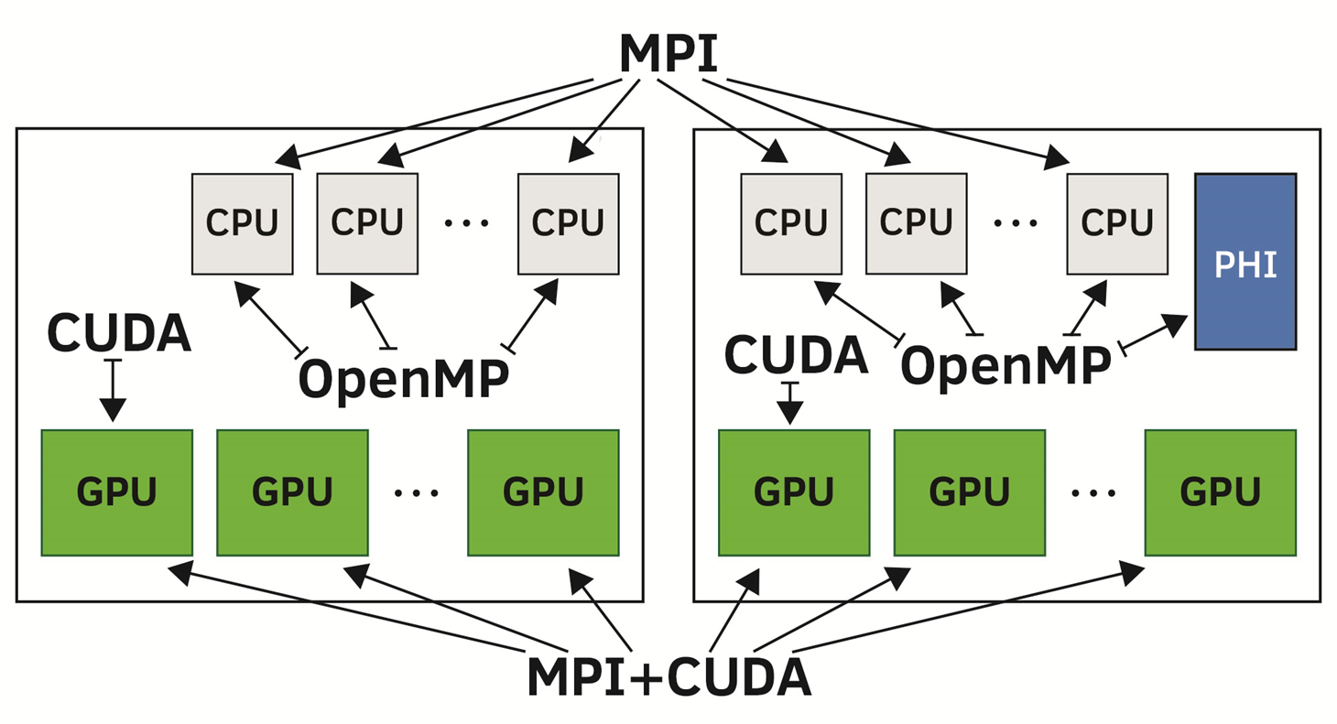
Parallel technologies: levels of parallelism In the last decade novel computational technologies and facilities becomes available: MP-CUDA-Accelerators?...
#node 1
#node 2
How to control hybrid hardware: MPI – OpenMP – CUDA - OpenCL ...

Slide 7
SLURM
Slurm workload manager
Used in HybriLIT
Assigns priorities to every job
Everyone gets fair share of computing power
Source: https://slurm.net/branding/
Slurm is an open source and highly scalable cluster management and job scheduling system for large and small Linux clusters. Slurm requires no kernel modifications for its operation and is relatively self-contained. As a cluster workload manager, Slurm has three key functions. First, it allocates exclusive and/or non-exclusive access to resources to users for some duration of time so they can perform work. Second, it provides a framework for starting, executing, and monitoring work on the set of allocated nodes. Finally, it arbitrates contention for resources by managing a queue of pending work.

Slide 8
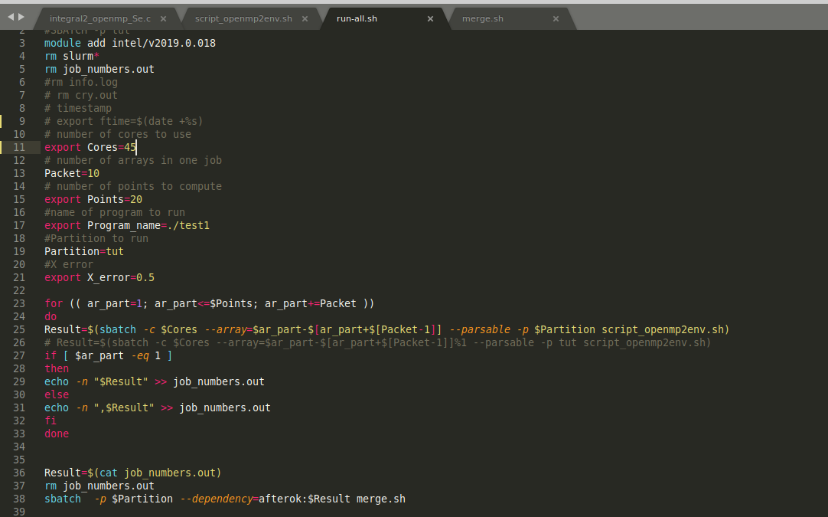
BASH
Bourne again shell
Standard in Unix shells
Powerful command language
Used to control user's jobs
Provides needed flexibility

Slide 9
Work description
Framework for testing of parallelization performance
Easy to change parameters – Cores, points and function
Jobs are sent to SLURM
Results are gathered – Bash
Root is used to make chart
Can be viewed in browser remotely – Salsa framework

Slide 10
Salsa framework

Slide 11
Method of testing
Computation of definite integral
Scripts are independent on the used function
Computed function was written in C language
Array command was used for slurm
Script for merging the results was developed

Slide 12
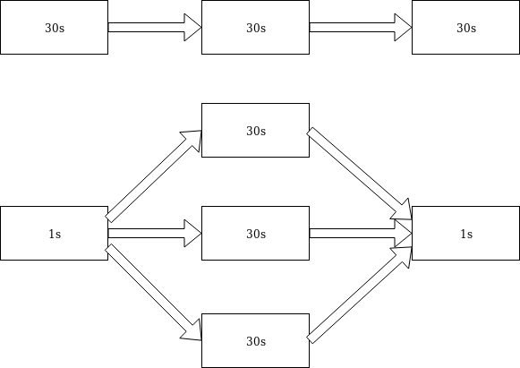
Advantage of parallelization
100 points to compute
Without any parallelization - ~9 hours
With basic parallelization - ~339 seconds
Adding more cores - ~ 100 seconds
Even more cores - ~ 15 second

Slide 13
Consistent integration using the trapezoidal rule
Calculate a double integral:
$$I=\iint_{D}^{ }{f\left(x,y;α\right)ⅆxⅆy, }$$
$$D=\left\{a≤x≤b, c≤y≤d\right\}$$
We will compute the double integral as the iterated integral.
The method of re-use of quadrature formulas:
$$I=\iint_{D}^{ }{f\left(x,y\right)ⅆxⅆy=\int_{c}^{d}{\left(\int_{a}^{b}{f\left(x,y\right)dx }\right)dy}}$$
$$I=\int_{c}^{d}{F\left(y\right)dy, F\left(y\right)=\int_{a}^{b}{f\left(x,y\right)dx }}$$
Trapezoidal rule:
$$q_{1,i}=\left\{\begin{aligned}\frac{1}{2}, i=0,i=N_{x} \\ 1, i=1,2,…,N_{x}−1\end{aligned}\right.$$
$F\left(y_{j}\right)≈h_{x}∙\sum_{i=0}^{N_{x}}{q_{1,i}∙f(x_{i},y_{j}})$,
$$f_{1}$$
$$S_{1}=\frac{1}{2}\left(f_{0}+f_{1}\right)∙h_{x}$$
$$S_{2}=\frac{1}{2}\left(f_{1}+f_{2}\right)∙h_{x}$$
$$f_{0}$$
$$f_{2}$$
$$h_{x}$$
$$h_{x}$$

Slide 14
Consistent integration using the trapezoidal rule
Trapezoidal rule:
$$q_{2,j}=\left\{\begin{aligned}\frac{1}{2} for j=0,j=N_{y} \\ 1 for j=1,2,…,N_{y}−1\end{aligned}\right.$$
$I≈h_{y}∙\sum_{j=0}^{N_{y}}{q_{2,j}∙F\left(y_{j}\right)}$,
$I≈{h_{x}∙h}_{y}∙\sum_{i=0}^{N_{x}}{\sum_{j=0}^{N_{y}}{q_{i,j}∙f\left({x_{i},y}_{j}\right)}}$,
$${ q}_{i,j}=\left\{ \begin{aligned}\frac{1}{4} for i=0,N_{x}; j=0,N_{y} ; \\ \frac{1}{2} for \left\{\begin{aligned}i=0,N_{x},j=1,2,…,N_{y}−1, \\ j=0,N_{y}, i=1,2,…,N_{x}−1;\end{aligned}\right. \\ 1 for i=1,2,…,N_{x}−1,j=1,2,…,N_{y}−1\end{aligned}\right.$$

Slide 15
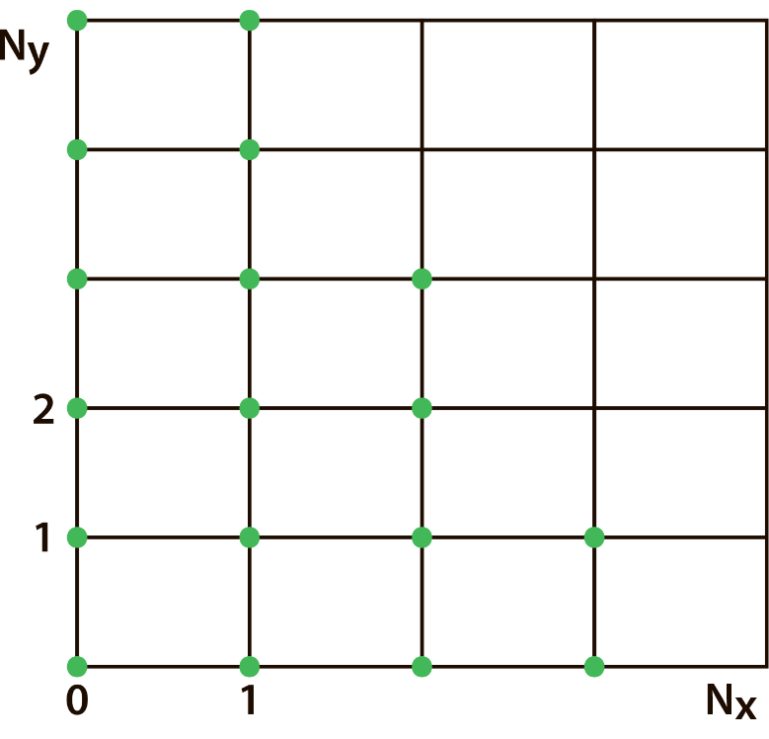
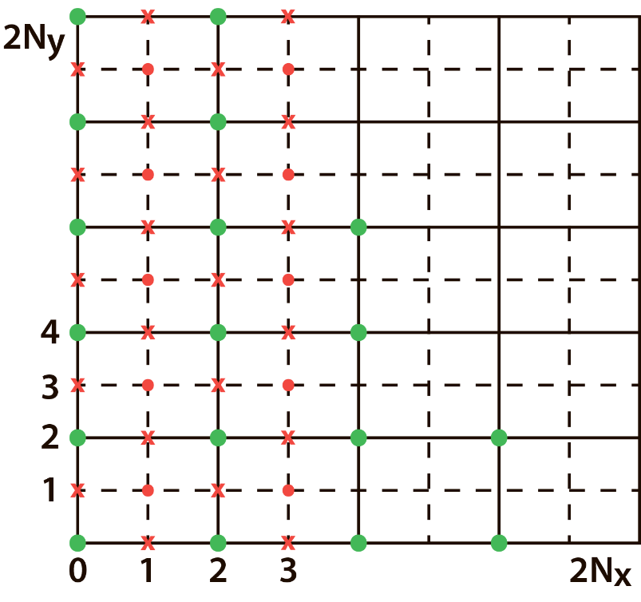
Consistent integration using the trapezoidal rule
Rule of C. Runge - the methods for estimating errors in numerical integration
$${I−I}_{h/2}≈\frac{I_{h/2}−I_{h}}{3}$$
$$I_{h}$$
$$I_{h/2}$$

Slide 16
Predicting and Measuring Parallel Performance
The success of parallelization is typically quantified by measuring the speedup of the parallel version relative to the serial version.
Speedup of parallel execution:
One computed number that
offers a tangible comparison of serial and parallel execution time is speedup:
S = $\frac{T_{s}}{T_{p}}$
$T_{s}$ - serial execution time
$T_{p}$ - parallel execution time
Efficiency of parallel execution:
Speedup is a metric to determine how much faster parallel execution is versus serial execution.
E = $\frac{S}{p}=\frac{T_{s}}{{pT}_{p}}$
$p$ - number of cores (threads)
Efficiency indicates how well software utilizes the computational resources of the system.

Slide 17
Results
Epsilon=10⁻¹¹
Epsilon=10⁻¹⁰

Slide 18
Results

Slide 19
Results

Slide 20
Results
Learned about parallel processing
Complete framework to measure parallel performance
Confirmed our theoretical ideas

Slide 21
Future Improvements
Increasing the number of points which we used to measure
Try different functions with varying complexity
Add more functions to the ROOT scripts

Slide 22
THANK YOU FOR YOUR ATTENTION

